Slide 1

ENGLAND history and fun
Ana’s Tour

Slide 2

BOARDING PASS
UDI
Ana’s Tour
B345
SP
D8
NOTE:
LONDON
29E
O melhor plano para você! Venha se aventurar com total segurança e ótimos planejamentos para uma melhor viagem.
The best plan for you! Come and venture with total safety and great plans for a better trip.

Slide 3
REQUISITOS PARA VIAGEM
Documento de Identificação
Visto e Passaporte
Passagem
Moeda
Comprovante de Vacinas (CIVP)
English
Identification document
Visa and passport
Passage
Currency
Proof of Vaccines

Slide 4
REQUISITOS PARA VIAGEM
Comprovante Financeiro
Reservas
Seguro de viagem
Carteira de Motorista/ Locomoção
English
Financial proof
Reservations
Travel insurance
Driver's license/
Locomotion

Slide 5
01
The Plan
Passagens
e Plano de Viagem

Slide 6
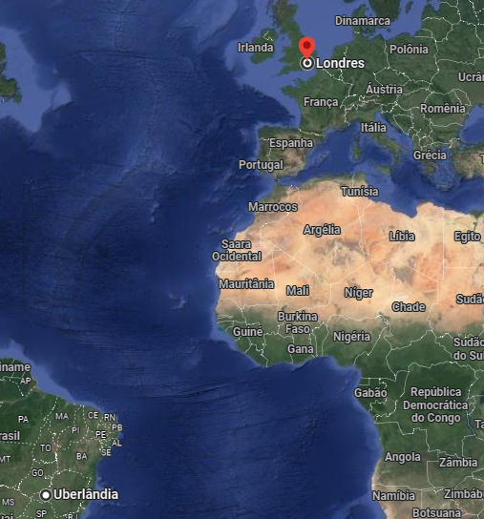
PREÇO DAS PASSAGENS
Passagem Aérea / flights
Ida e volta = R$ 8346,00
Round-trip = £ 1.393,98
Companhia aérea / Airline: United

Slide 7
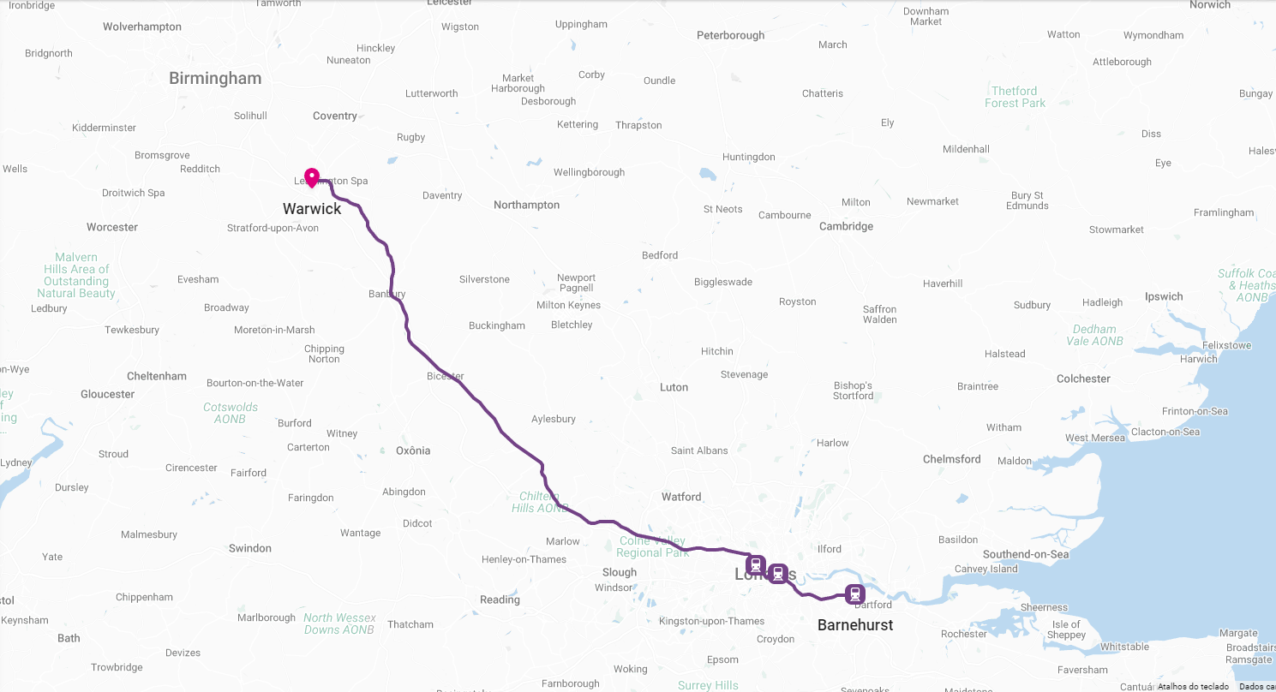
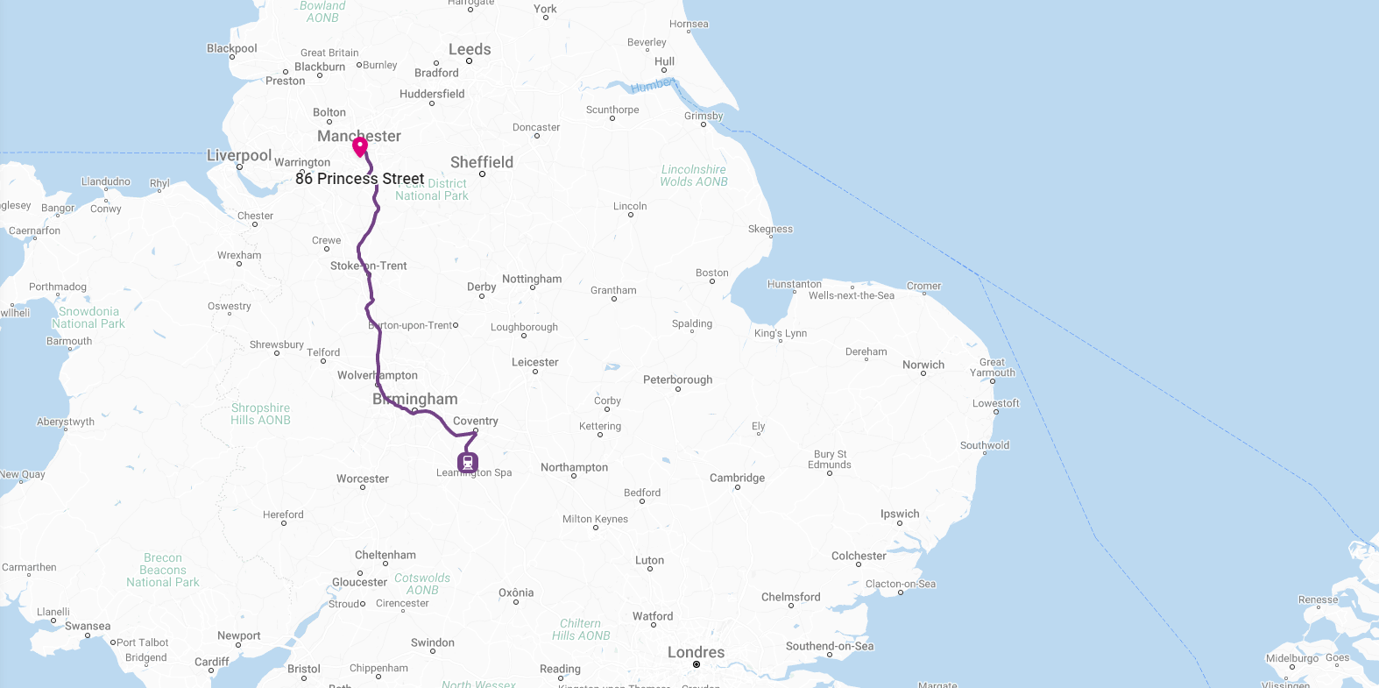
Train
R$ 275,06
£ 46,21
R$ 264,87
£ 44,50

Slide 8
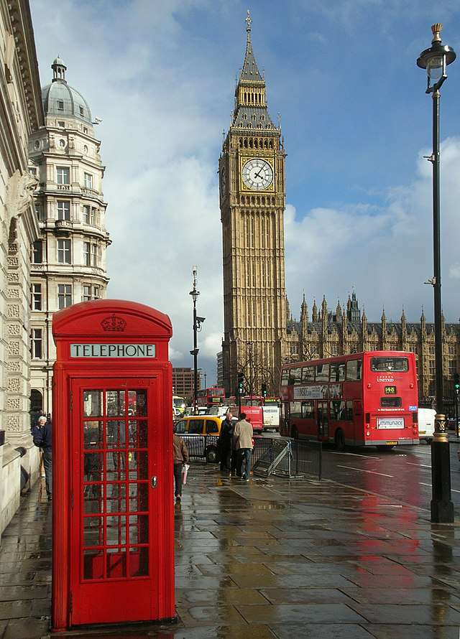
London

Slide 9
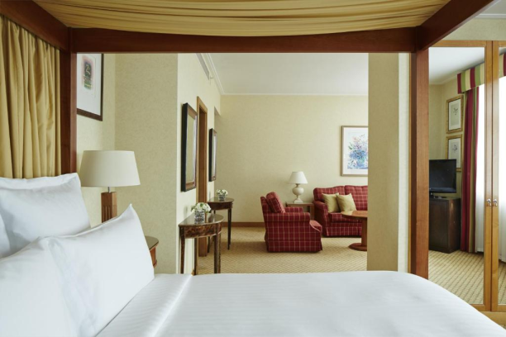
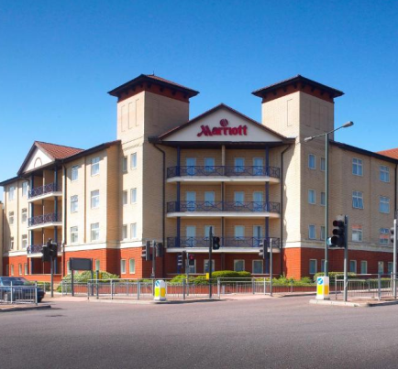
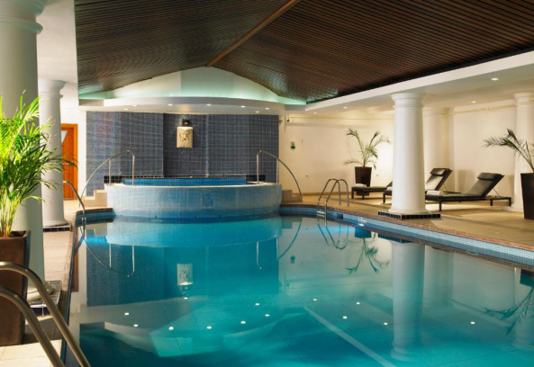
LODGING
Bexleyheath Marriott Hotel R$734,00 / £ 122,78 a noite/per night

Slide 10
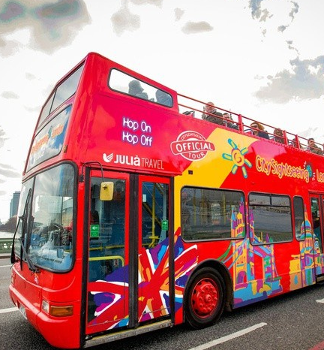
Bus
Excursão de ônibus hop-on hop-off de 24 horas
24-hour hop-on hop-off bus tour
Paragens perto de todos os principais pontos turísticos Stops near all the major sights
Áudio-guia em 11 idiomas
Audio guide in 11 languages
Medidas de higiene completas
Full hygiene measures

Slide 11
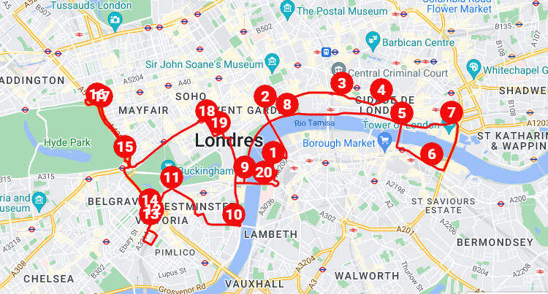

Slide 12
Rota / Course
1-Belvedere Road
2-Aldwych (One Aldwych Hotel)
3-Ludgate Hill (St Paul's Cathedral)
4-Queen Victoria Street (The City)
5-London Bridge
6-Tooley Street (Tower Bridge)
7-Tower Hill (Tower of London)
8-Victoria Embankment
9-Westminster Bridge (Big Ben)
10-Horseferry Road
11-Buckingham Gate (Buckingham Palace)
12-Buckingham Palace Road (Victoria Station)
13-Buckingham Palace Road, Stop Z12
14-Grosvenor Gardens
15-Queen Elizabeth Gate, Hyde Park
16-Marble Arch (Speakers Corner)
17-Marble Arch (Park Lane)
18-Haymarket
19-Pall Mall East (Trafalgar Square)
20-Westminster Bridge (South)
Para mais informações acesse nosso site ou entre em contato em nossas redes sociais

Slide 13
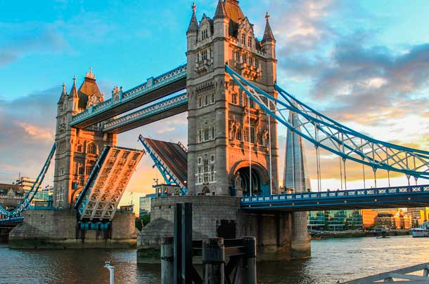
Tourist Spots
Tower Bridge
Price: £ 11,40

Slide 14
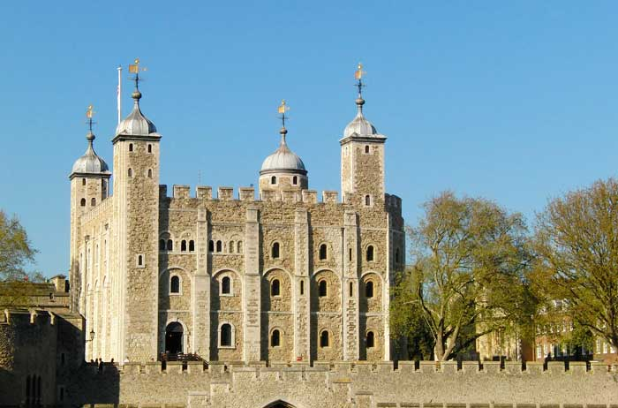
Tourist Spots
Tower of London
Price: £ 29,90

Slide 15
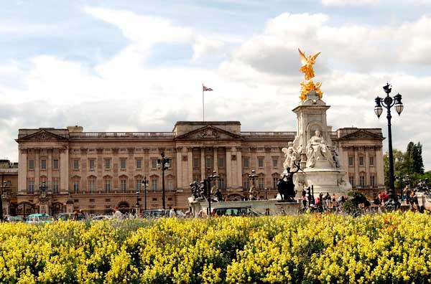
Tourist Spots
Buckingham Gate
Price: £ 15,25

Slide 16
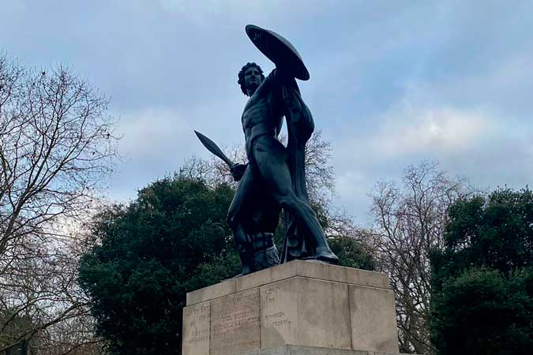
Tourist Spots
Hyde Park
Price: free

Slide 17
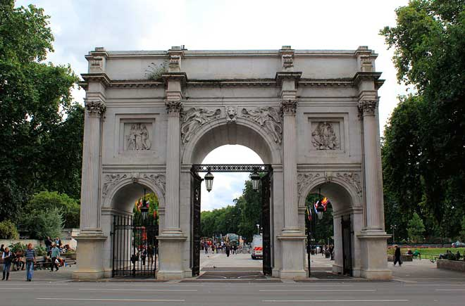
Tourist Spots
Marble Arch
Price: free

Slide 18
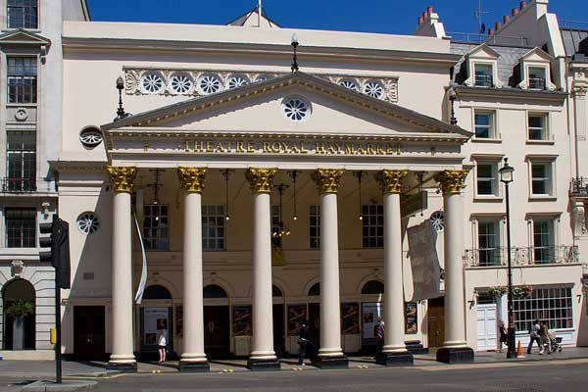
Tourist Spots
Theatre Royal Haymarket
Price: £ 15 - £ 95

Slide 19
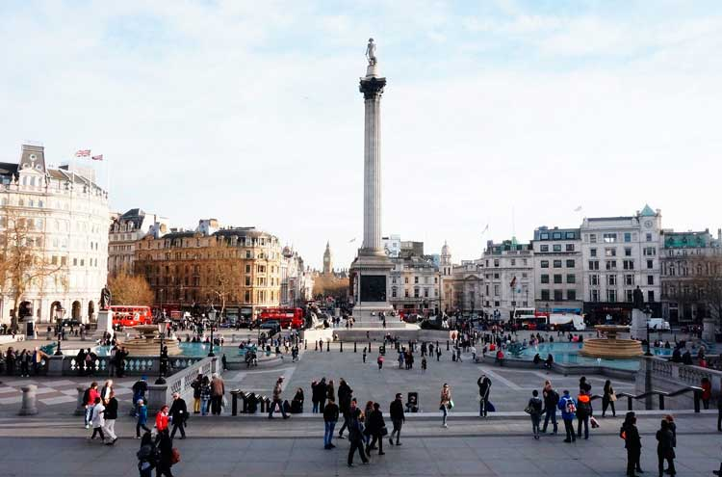
Tourist Spots
Pall Mall East
Price: free

Slide 20
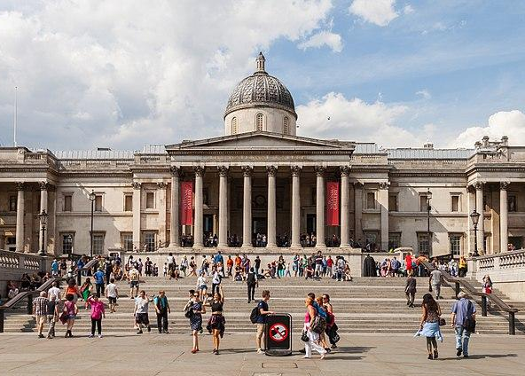
Tourist Spots
National Gallery
Price: free

Slide 21
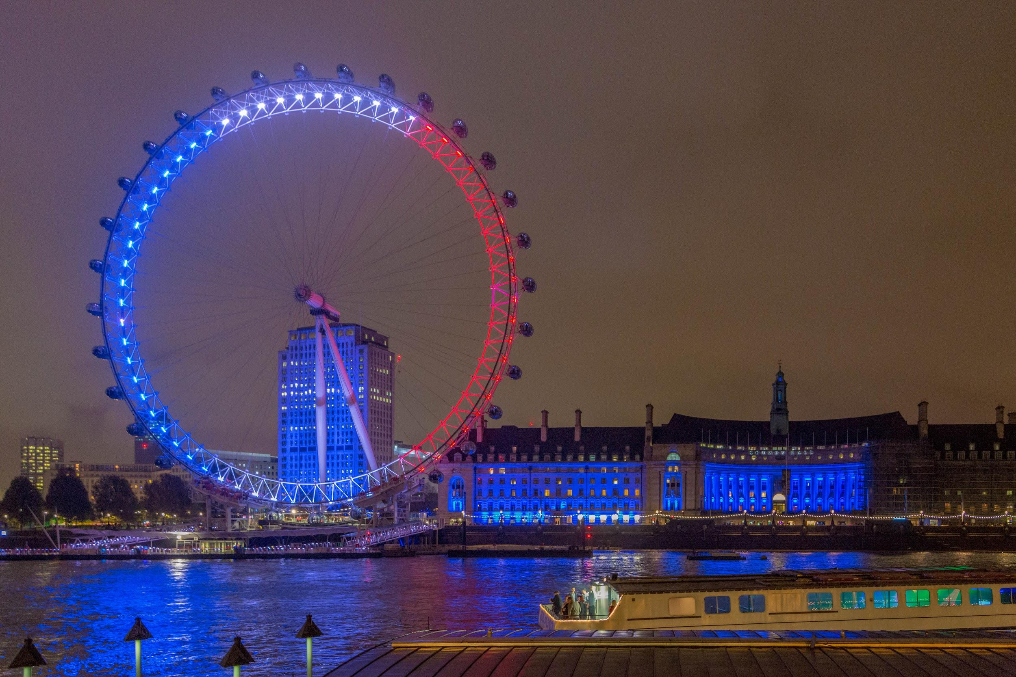
Tourist Spots
London Eye
Price: £27

Slide 22
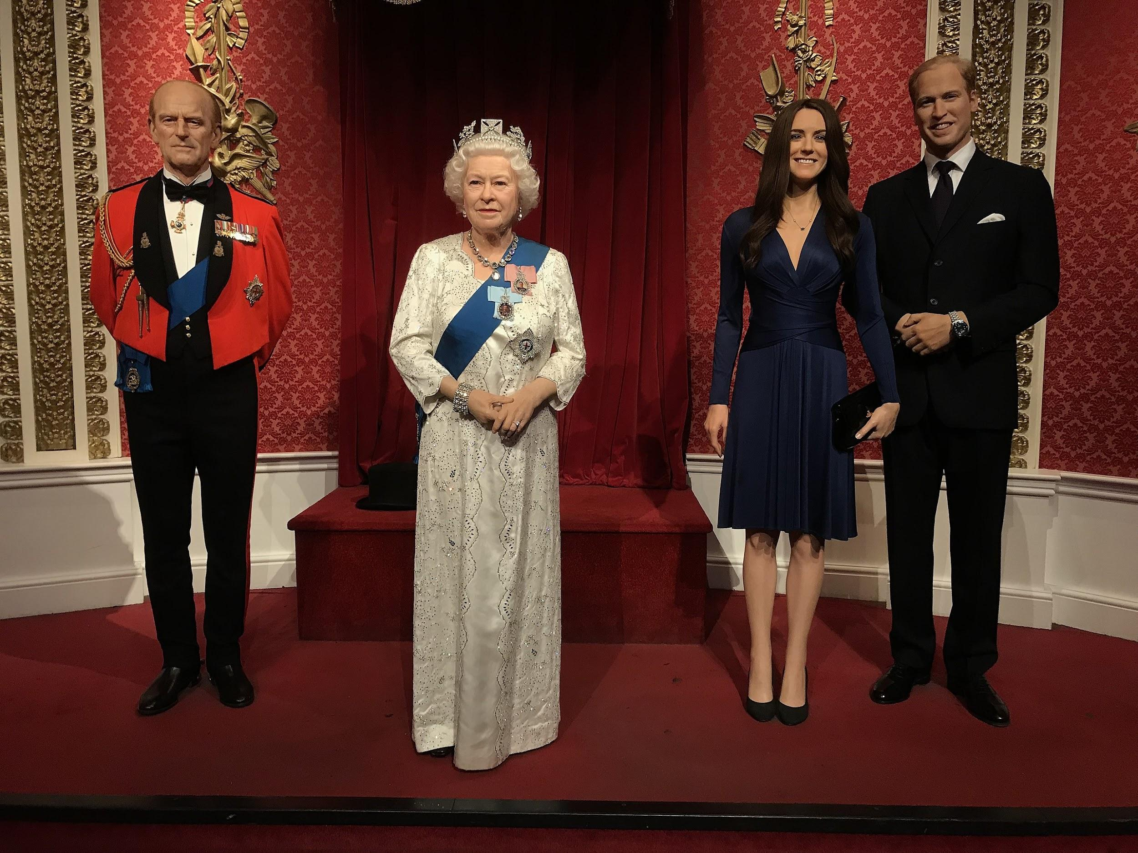
Tourist Spots
Madame Tussauds London
Price: £34,27

Slide 23
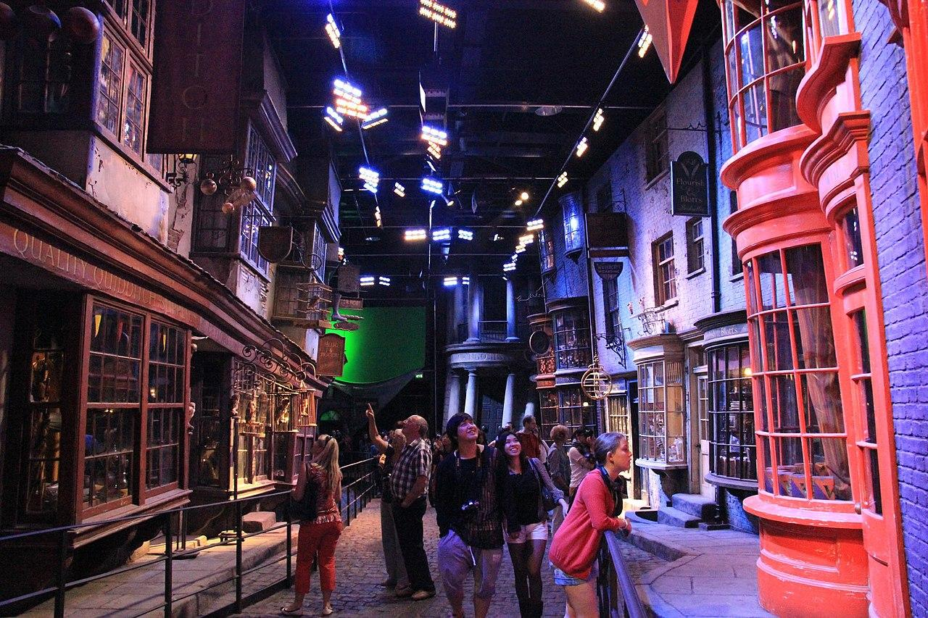
Tourist Spots
Harry Potter Studio
Price: £84 *a parte

Slide 24
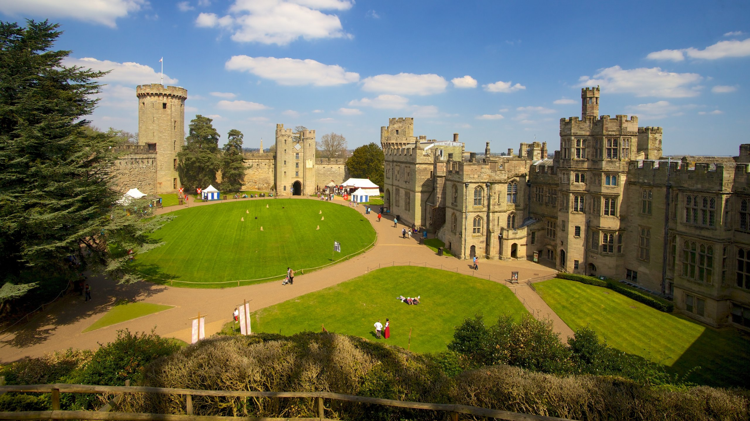
Warwick

Slide 25
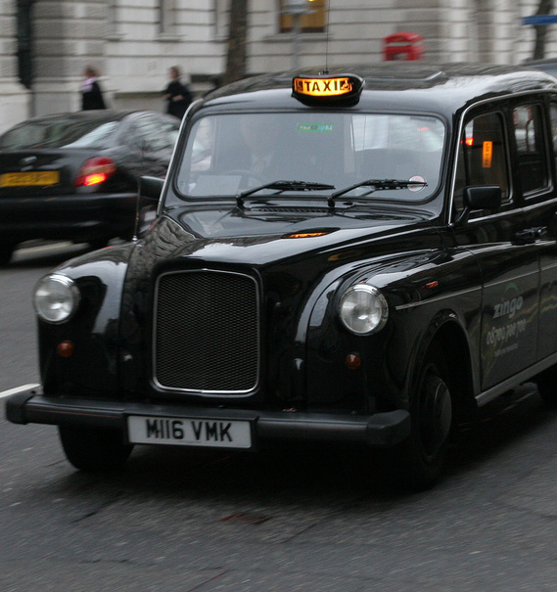
Taxi
Price: £6,72
Preço: R$40,73

Slide 26
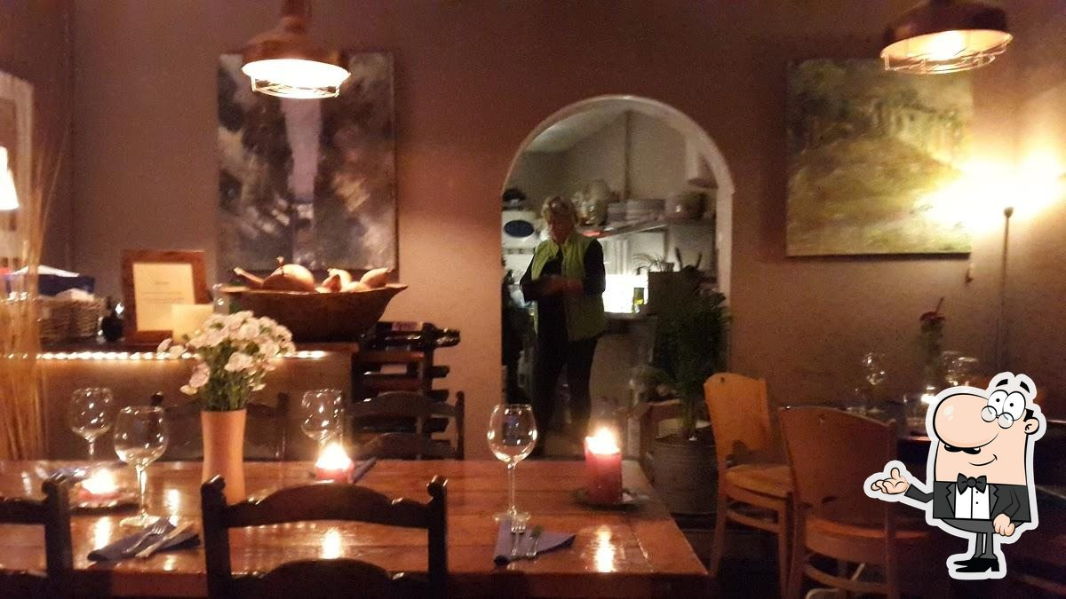
Restaurant
La Mesa
Price: £45,17 *a parte

Slide 27
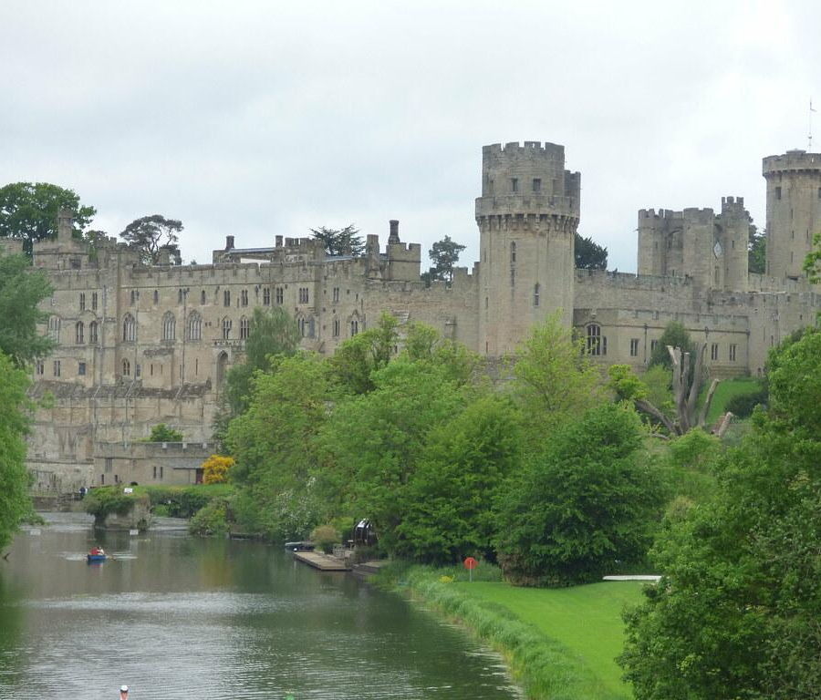
Tourist Spots
Warwick Hidden Gems
Price: £18

Slide 28
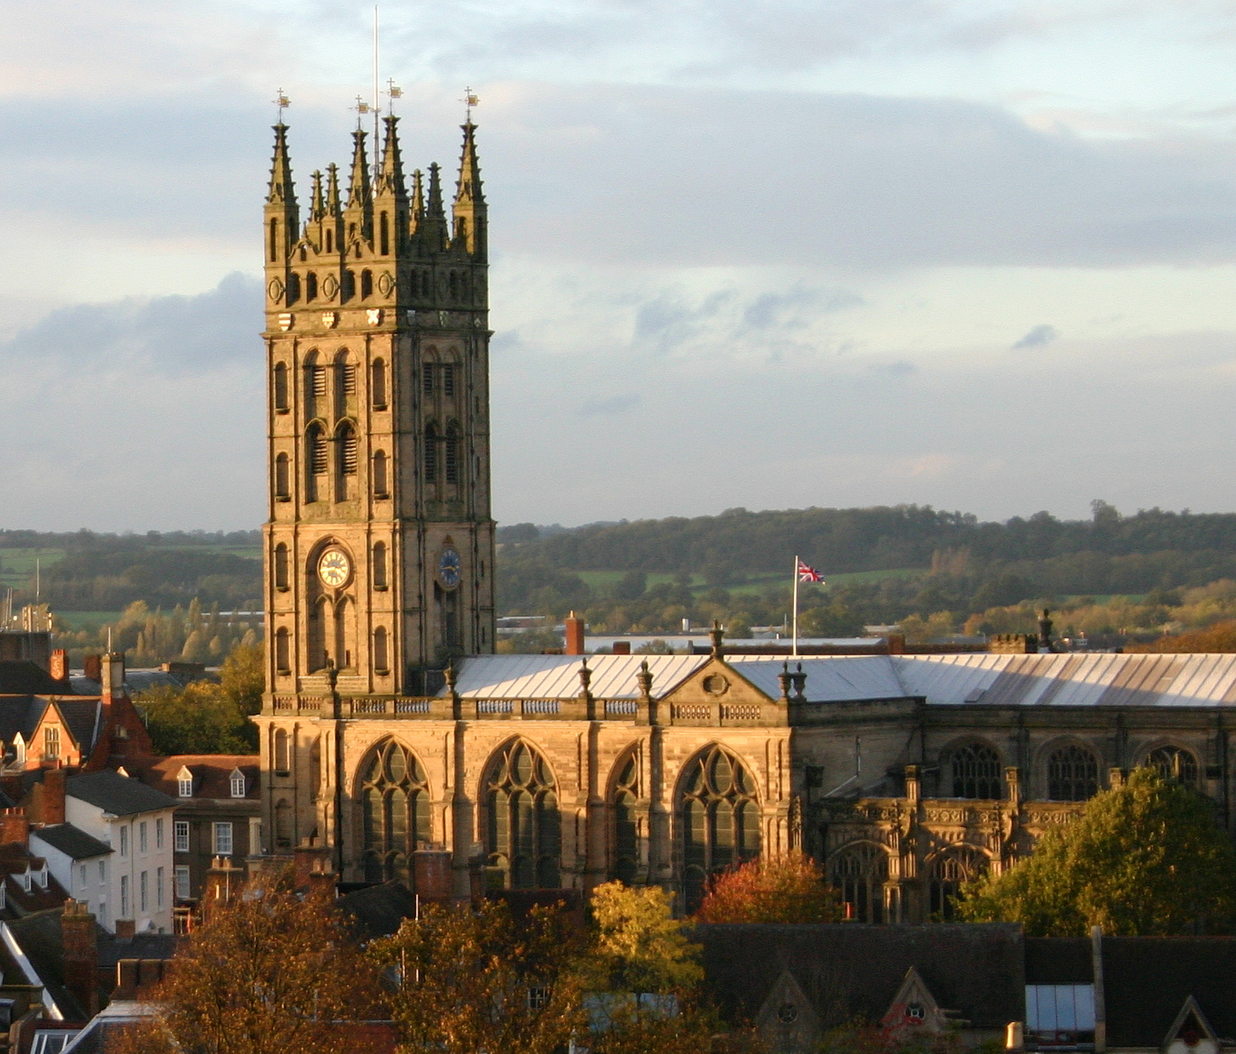
Tourist Spots
Collegiate Church of St Mary's
Price: free

Slide 29
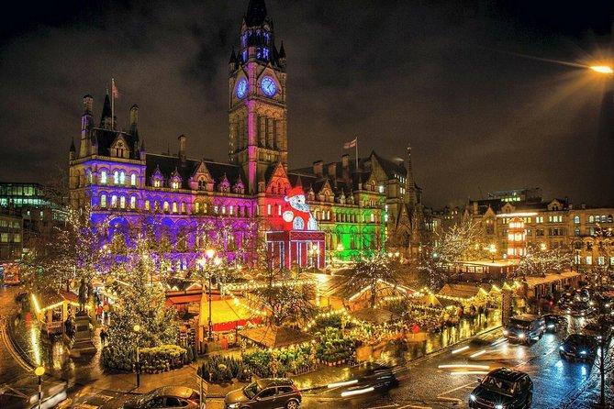
Manchester

Slide 30
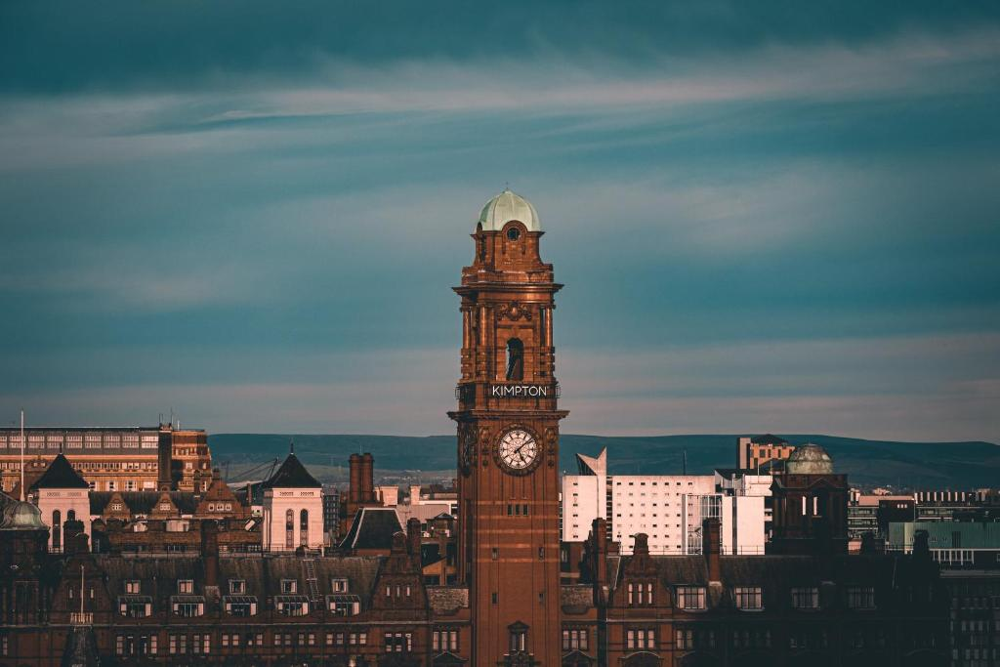
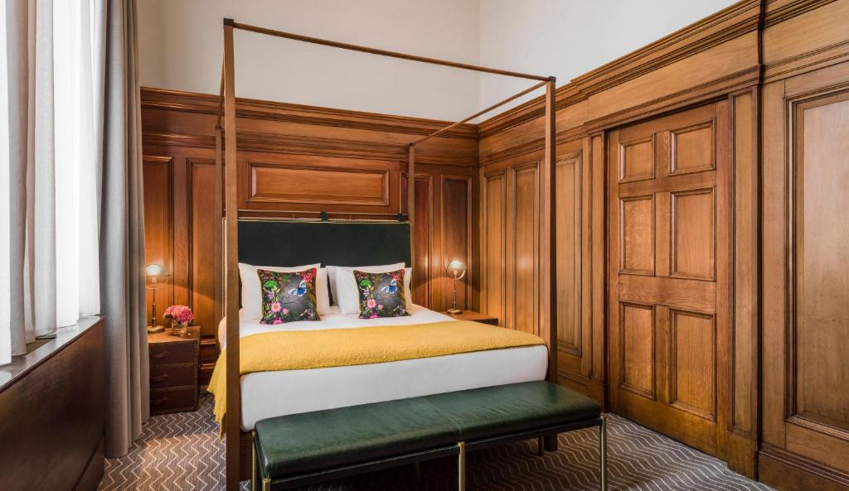
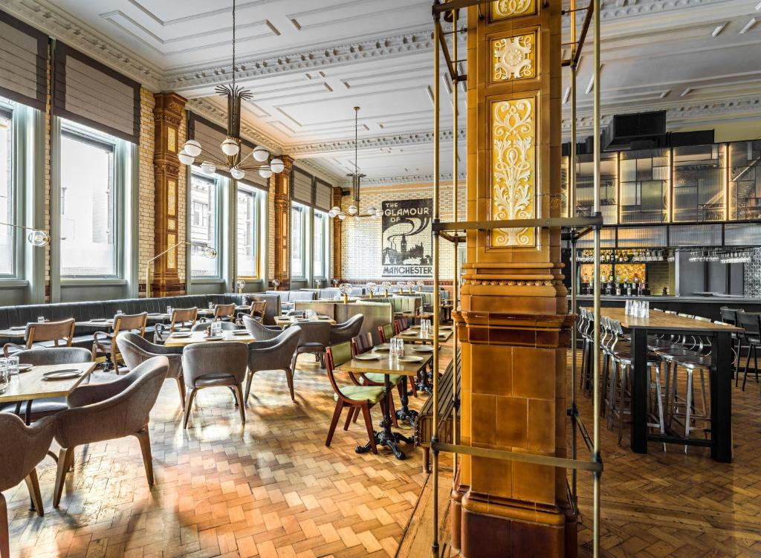
LODGING
Kimpton Clocktower Hotel R$644,00 / £ 108,19 a noite/per night

Slide 31
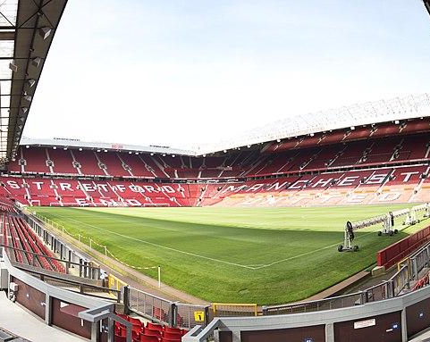
Tourist Spots
Manchester Stadium
Old Trafford
Price: £ 5 — £ 25

Slide 32
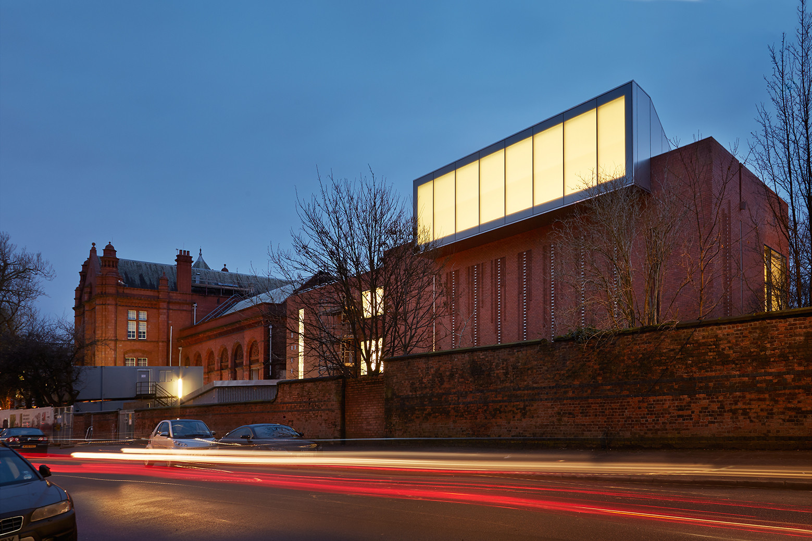
Tourist Spots
The Whitworth
Price: free

Slide 33
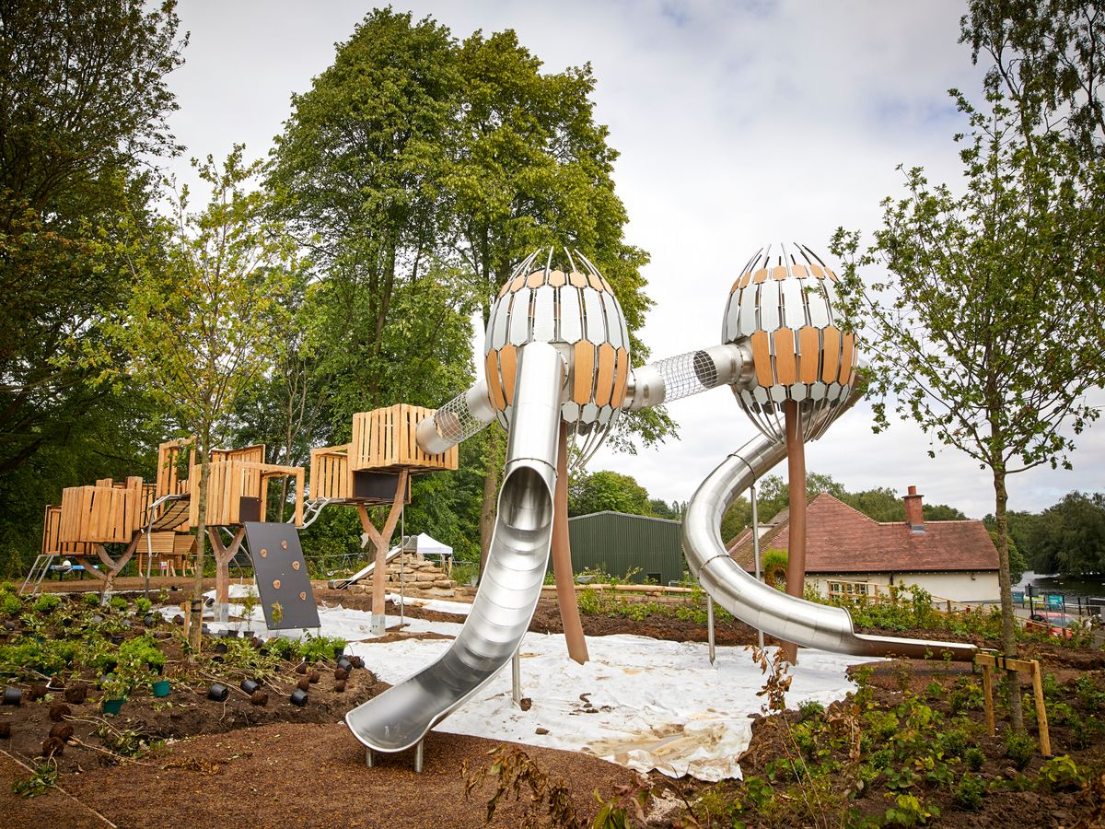
Tourist Spots
Heaton Park
Price: £1 — £3

Slide 34
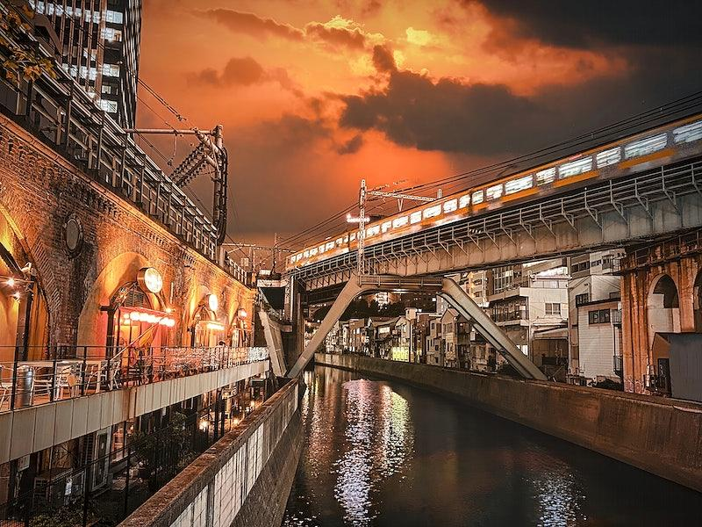
Tourist Spots
Castlefield
Price: free

Slide 35
Final Price
R$ 11.436,28
£ 1922,91

Slide 36
THANKS!
Do you have any questions?
anastour@gmail.co
+91 620 421 838

Slide 37
02
METHODOLOGY
You can describe the topic of the section here

Slide 38
OUR METHODOLOGY
RESEARCH
ANALYSIS
DATA STUDY
COMPARISON
Despite being red, Mars is a cold place
Earth is the planet where we all live
04
01
03
02
Venus is the second planet from the Sun
Jupiter is the biggest planet of them all

Slide 39
SOCIAL SCHEDULE
NOVEMBER
SUN | MON | TUE | WED | THU | FRI | SAT
 | 01 | 02 | 03 | 04 | 05 | 06
07 | 08 | 09 | 10 | 11 | 12 | 13
14 | 15 | 16 | 17 | 18 | 19 | 20
21 | 22 | 23 | 24 | 25 | 26 | 27
28 | 29 | 30
16th
25th
Mercury is the smallest planet
Despite being red, Mars is a cold place

Slide 40
THANKS!
Do you have any questions?
youremail@freepik.com
+91 620 421 838
yourcompany.com

Slide 41
PREÇO FINAL
RESEARCH
ANALYSIS
DATA STUDY
COMPARISON
Despite being red, Mars is a cold place
Earth is the planet where we al live
04
01
03
02
Venus is the second planet from the Sun
Jupiter is the biggest planet of them all

Slide 42
03
RESULTS ANALYSIS
You can describe the topic of the section here

Slide 43
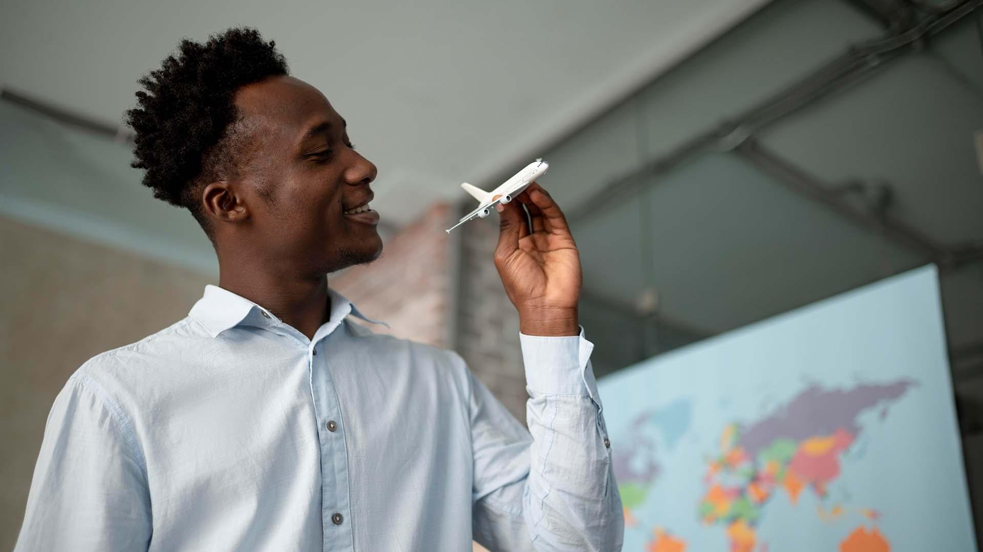
A PICTURE IS WORTH A THOUSAND WORDS

Slide 44
Mercury is the closest planet to the Sun and the smallest one in the Solar System—it’s only a bit larger than the Moon
THEORY 02
Venus has a beautiful name and is the second planet from the Sun. It’s hot and has a poisonous atmosphere
https://docs.google.com/presentation/d/1xoUOyJfv2BvEmxksOzo8kRQHFS6l6WpDg-iYAfVDyNs/edit#slide=id.g1527607b733_0_380

Slide 45
SOCIAL PROBLEMS
TYPE OF AIRCRAFT
TYPE 01
TYPE 02
TYPE 03
TYPE 04
Venus is the second planet from the Sun
Jupiter is the biggest planet of them all
Saturn is a gas giant and has several rings
Despite being red, Mars is a cold place

Slide 46
AWESOME WORDS

Slide 47
RESULT ANALYSIS
2020
75%
Venus is the second planet from the Sun
LANDING PERCENTAGE
2021
Venus is the second planet from the Sun
50%
Jupiter is the biggest planet of them all

Slide 48
CONCLUSIONS
01
02
MERCURY
It’s the closest planet to the Sun and the smallest in the Solar System
VENUS
Venus has a beautiful name, but also extremely high temperatures

Slide 49
BIBLIOGRAPHICAL REFERENCES
Author (year). Title of the publication. Publisher
Author (year). Title of the publication. Publisher
Author (year). Title of the publication. Publisher
Author (year). Title of the publication. Publisher
Author (year). Title of the publication. Publisher
Author (year). Title of the publication. Publisher

Slide 50
30,000
20,000
50,000
Mercury is the smallest planet
Neptune is very far from the Sun
Earth is the planet we live on

Slide 51
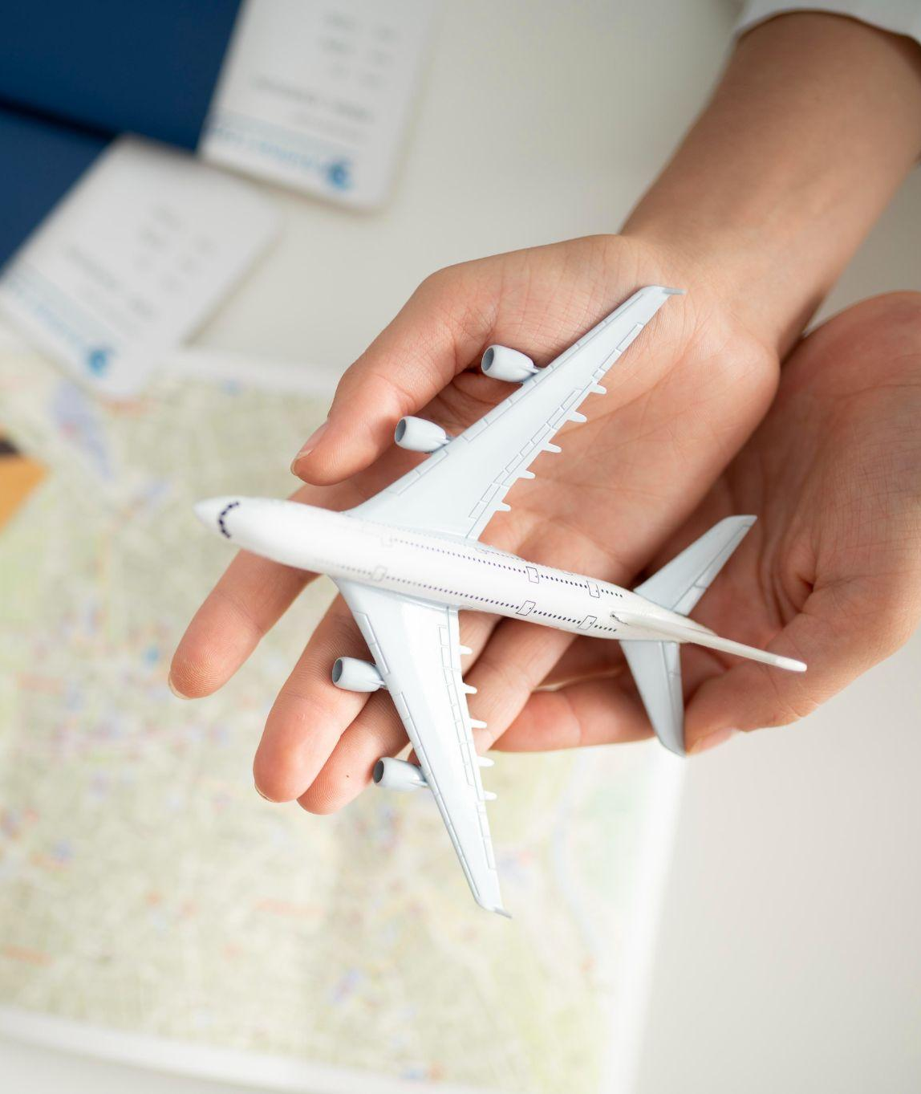
HERE YOU HAVE FOUR COLUMNS
MARS
JUPITER
VENUS
SATURN
Despite being red, Mars is a cold place
It’s the biggest planet in the Solar System
Venus is the second planet from the Sun
Saturn is a gas giant and has several rings

Slide 52
AIRPORTS IN THE WORLD
AIRPORT 02
Jupiter is the biggest planet of them all
AIRPORT 01
Venus is the second planet from the Sun

Slide 53
AIRPLANE TIMELINE
2018
2020
Venus is the second planet from the Sun
Jupiter is the biggest planet of them all
2017
2019
Despite being red, Mars is a cold place
Saturn is a gas giant and has several rings

Slide 54
150,000
Big numbers catch your audience’s attention

Slide 55
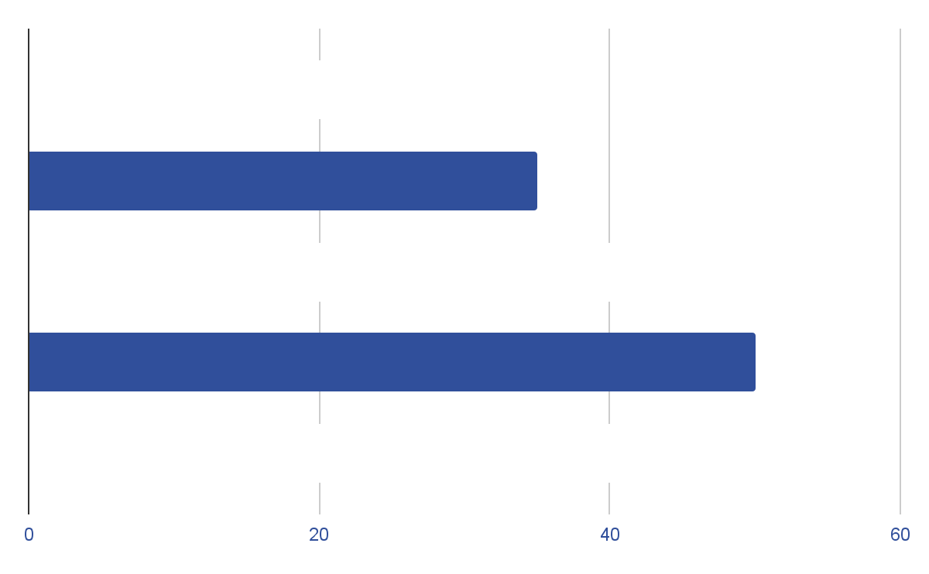
SOCIAL GRAPH
2017
2018
VENUS
2019
Venus is the second planet from the Sun
2020
2021
Follow the link in the graph to modify its data and then paste the new one here. For more info, click here

Slide 56
SIX COLUMNS
MERCURY
SATURN
JUPITER
MARS
VENUS
NEPTUNE
It’s the closest planet to the Sun
It’s composed of hydrogen and helium
Jupiter is the biggest planet of them all
Mars is actually a very cold place
Venus is the second planet from the Sun
It’s the farthest planet from the Sun

Slide 57
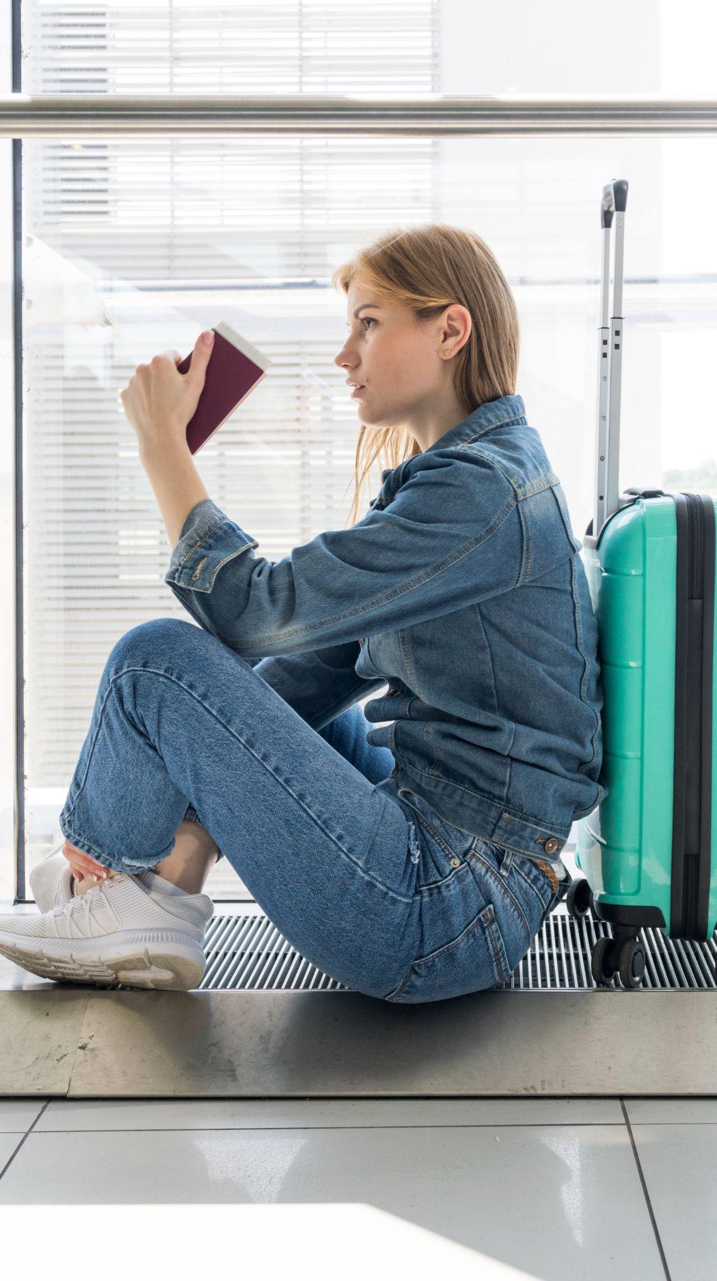
PHONE SCREENSHOT
You can replace the image on the screen with your own work. Just right-click on it and select “Replace image”

Slide 58
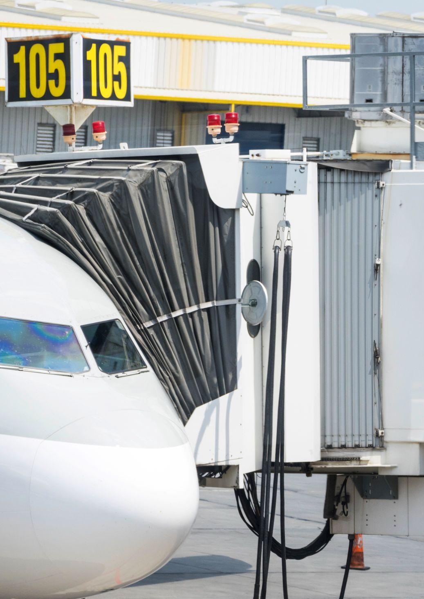
TABLET SCREENSHOT
You can replace the image on the screen with your own work. Just right-click on it and select “Replace image”

Slide 59
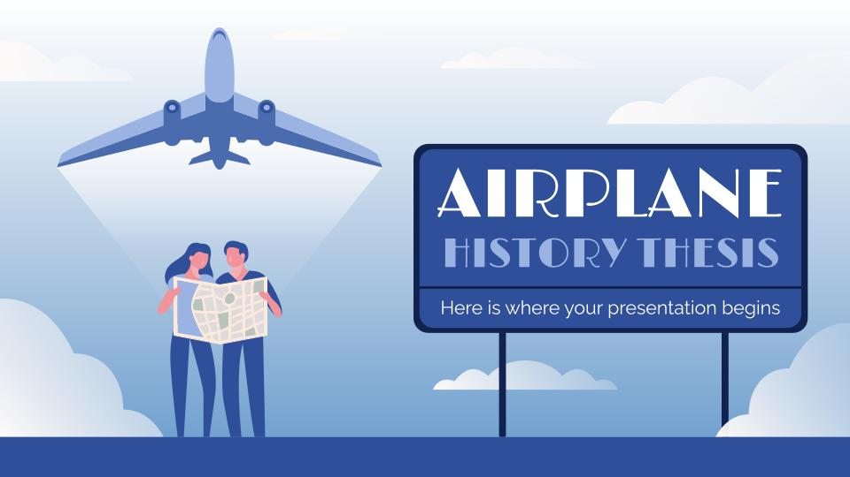
DESKTOP SCREENSHOT
You can replace the image on the screen with your own work. Just right-click on it and select “Replace image”

Slide 60
ALTERNATIVE RESOURCES

Slide 61
RESOURCES
Did you like the resources on this template? Get them for free at our other websites:
PHOTOS:
Side view of woman facing camera in airport
Medium shot man holding small plane
Close up hands holding small plane top view
Side view of woman sitting in airport
Boarding bridge connected to airplane
VECTORS:
Flat vintage travel poster with airplane
Travel landing page
Flat vintage travel poster with beach
Travel landing page
Travel computer with airplane and accessories
Plane flying around the world background
ICONS:
Icon Pack: Aviation | Filled

Slide 62
ICON PACK: AVIATION | FLAT

Slide 63
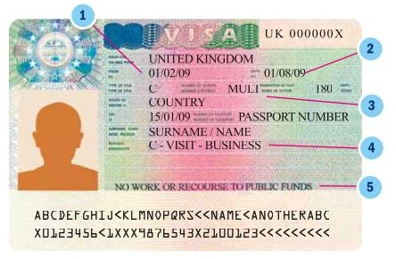
https://visa.vfsglobal.com/bra/en/gbr/apply-visa
03

Slide 64
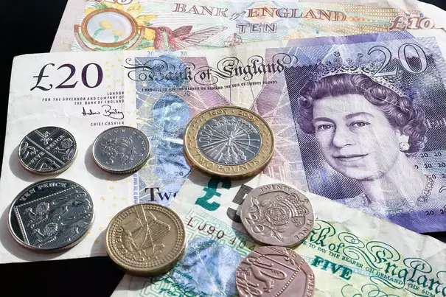
Uberlândia: Casa de Câmbio - Center shopping
Londres: Thomas Exchang global
03

Slide 65
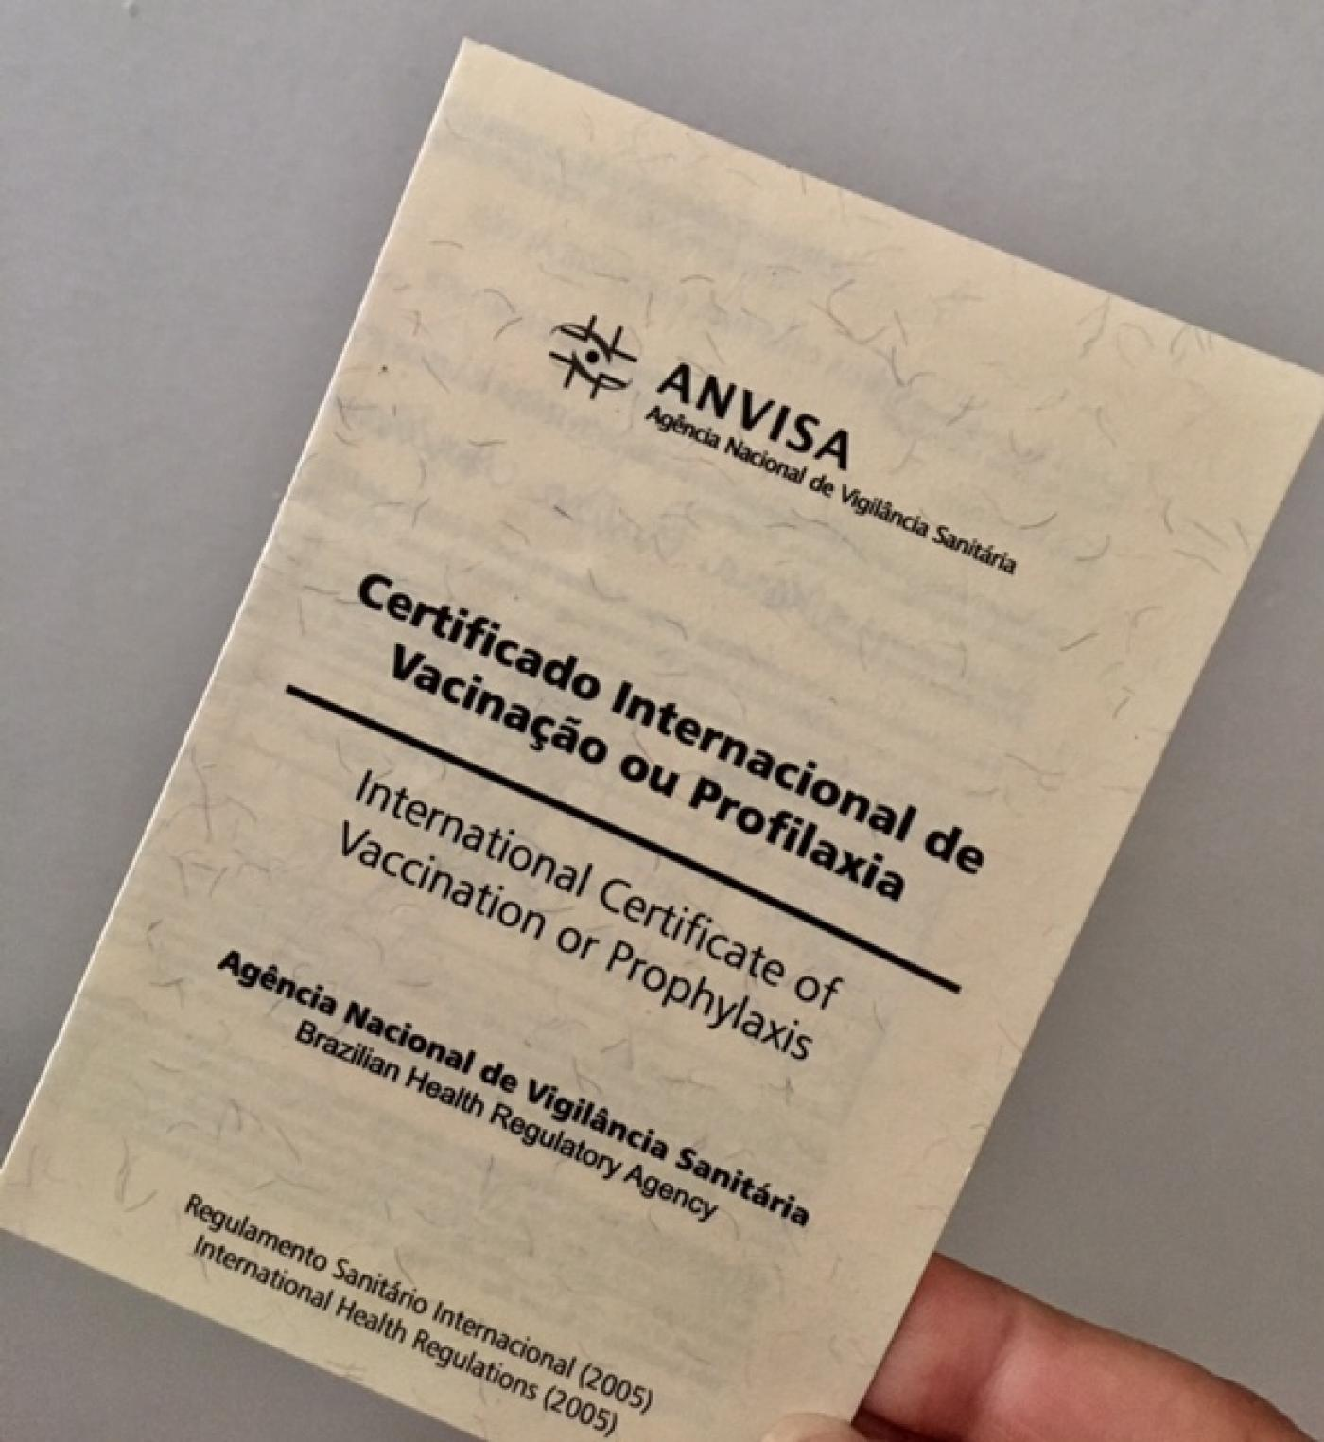
https://www.gov.br/pt-br/servicos/obter-o-certificado-internacional-de-vacinacao-e-profilaxia
03

